Slide 1




Using Rust at Parity to Build Substrate to Build Polkadot

Slide 2
Roadmap
Reviewing Rust Pros/Cons
Introducing WASM
Parity Stack
Substrate Blockchain Framework
Polkadot Platform for Connected Blockchains

Slide 3
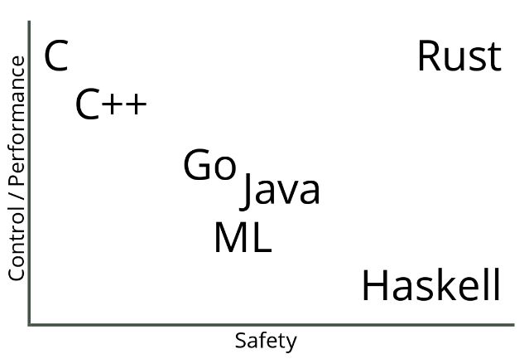
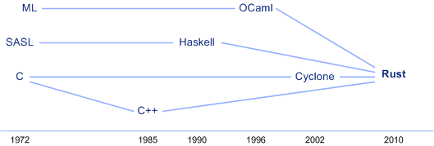
“A language that doesn’t affect the way you think about programming, is not worth knowing.” - Alan Perlis

Slide 4
Rust is a systems programming language that runs blazingly fast, prevents segfaults, and guarantees thread safety.
Featuring
zero-cost abstractions
move semantics
guaranteed memory safety
threads without data races
trait-based generics
pattern matching
type inference
minimal runtime
efficient C bindings

Slide 5
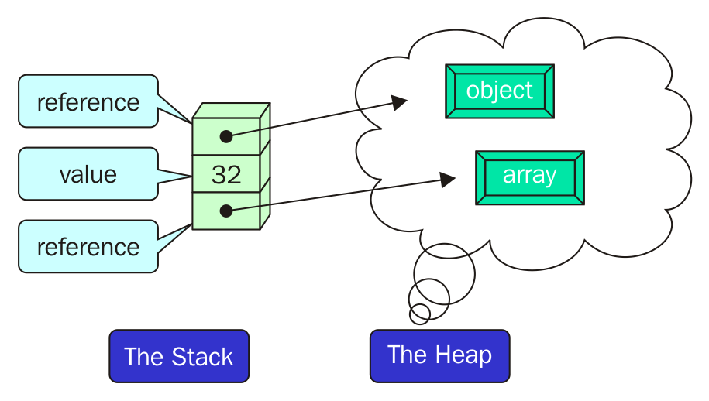
The Stack and the Heap

Slide 6
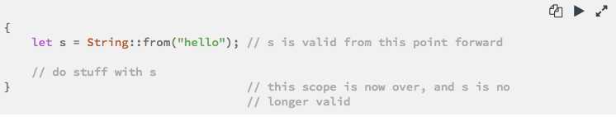
Safety, Speed, and Concurrency (1)
One of Rust’s most unique and compelling features is Ownership, which it uses to achieve memory safety.
Each value in Rust has a variable called its owner.
There can only be one owner at a time.
When the owner goes out of scope, the value will be dropped.

Slide 7
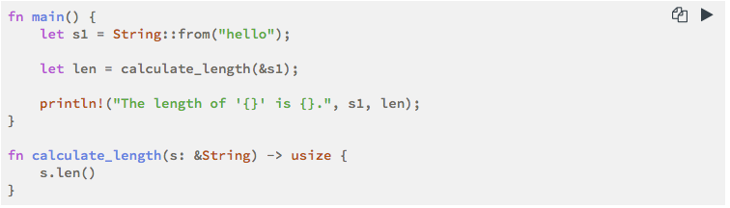
Safety, Speed, and Concurrency (2)
Rust creates memory pointers optimistically, checks memory pointers’ limited accesses at the compiler time with the usage of References and Borrowing.
We use references to pass a value to a function without transferring ownership
Using references as function parameters is known as borrowing.

Slide 8
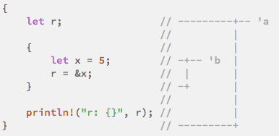
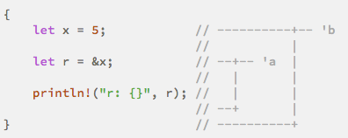
Safety, Speed, and Concurrency (3)
Automatic compile time memory management by checking the Lifetimes.
Every reference in Rust has a lifetime, which is the scope for which the reference is valid.
The Rust compiler has a borrow checker that compares the scopes to determine whether all borrows are valid.

Slide 9
“I call it my billion-dollar mistake. At that time, I was designing the first comprehensive type system for references in an object-oriented language...I couldn’t resist the temptation to put in a null reference, simply because it was so easy to implement. This has led to innumerable errors, vulnerabilities, and system crashes, which have probably caused a billion dollars of pain and damage in the last forty years.” - Tony Hoare (2009)
enum Option<T> {
Some(T),
None,
}
Because Option<T> and T are different types, the Rust compiler won’t allow us to use an Option<T> value as if it were definitely a valid value.

Slide 10
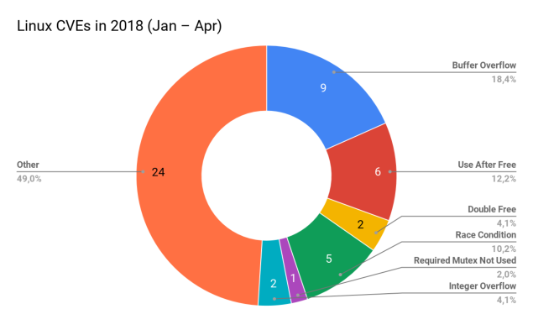
Memory Safety Issues are Impossible in Rust

Slide 11
WASM
Still discussing Parity design choices

Slide 12
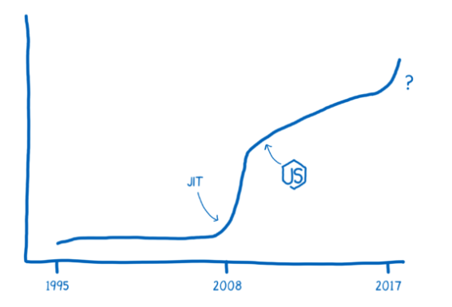
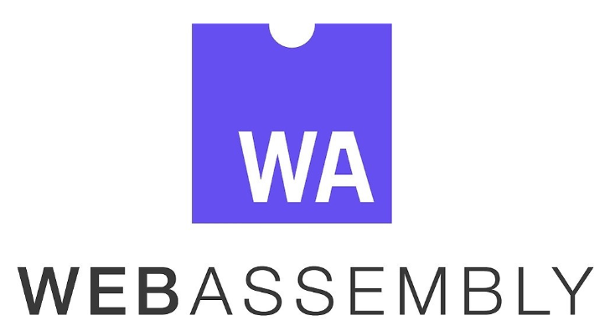

Slide 13
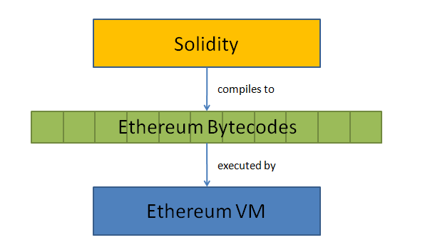
How does the current Ethereum stack work?
→ traditional computers contain instruction sets that function on inputs of 32 or 64-bit sizes
→ Ethereum Virtual Machine is a 256-bit computer

Slide 14
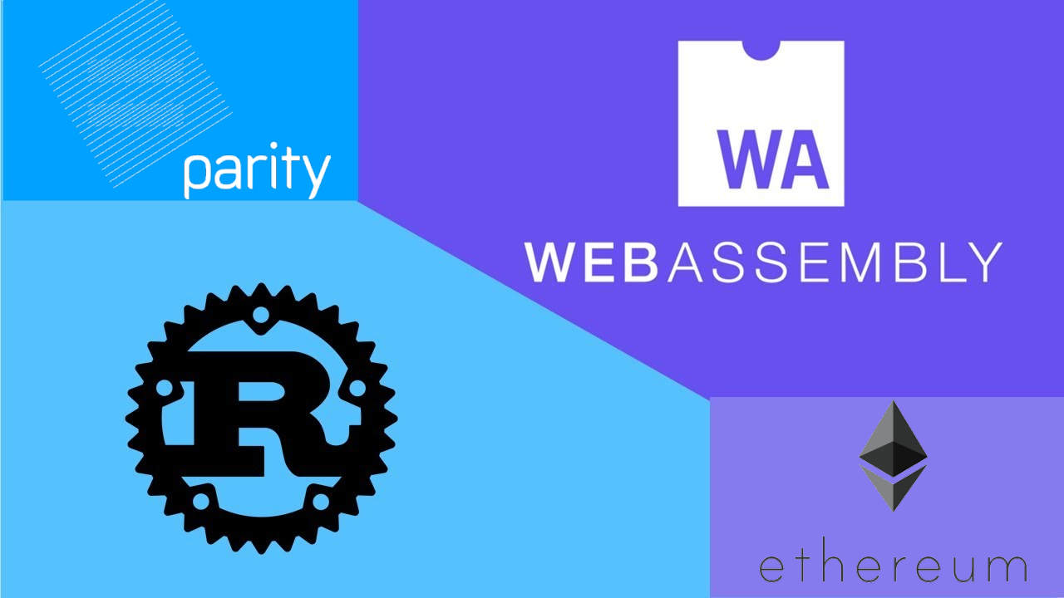
Parity chose WASM as the target
-- expands family of languages available to smart contract devs to include Rust, C/C++, C#, Typescript, Haxe, Kotlin
-- continually developed by Google, Apple, Microsoft, Mozilla, and Facebook
-- memory-safe, sandboxed, platform independent
-- high performance

Slide 15
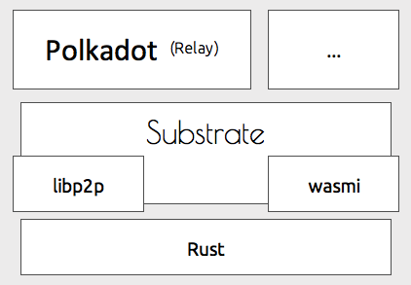
Parity Tech Stack 3.0

Slide 16
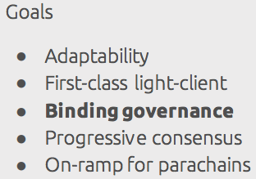
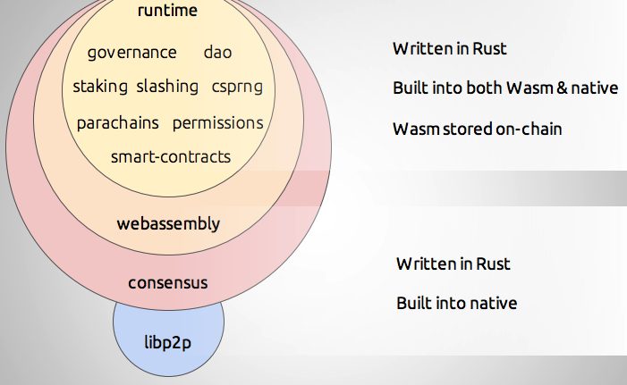
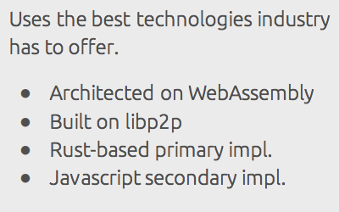
Substrate: Library to Build Blockchains

Slide 17
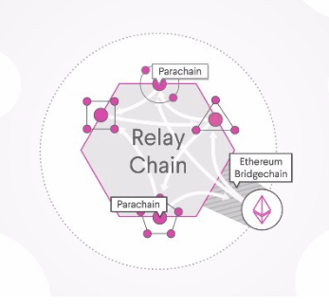
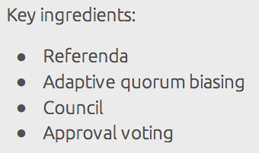
Polkadot: Bunch of Substrate Blockchains

Slide 18
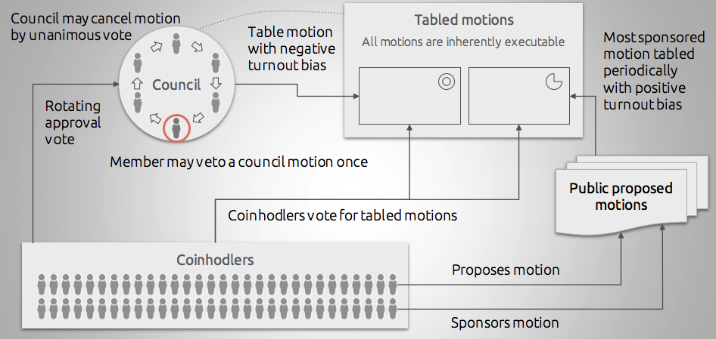

Slide 19
Polkadot Referenda
Public bonded proposals
Bond returned only once vote ends
Bond more $DOTs to sponsor a proposal
Every period T, most sponsored proposal is voted on
Stake-weighted voting
Super-majority required to carry unless 100% turnout
Motion autonomously executed

Slide 20
Polkadot Adaptive Quorum Biasing
Goal: No strict quorum, but increase bar to approval with lower turnout
“Positive Turnout Bias”
aye * \sqrt{turnout} > nay
Can be inverted to create opposite bias
aye > nay * \sqrt{turnout}
“Negative Turnout Bias”

Slide 21
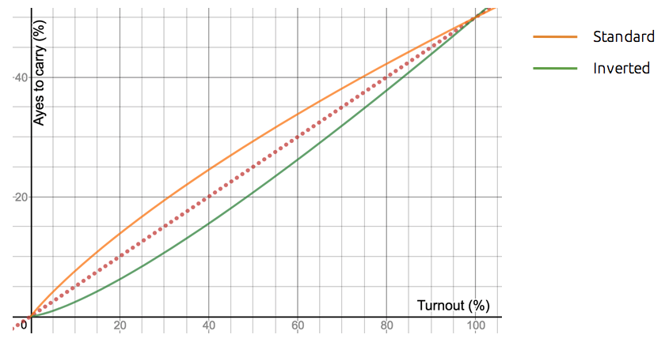

Slide 22
Polkadot Council Elections
Rotating approval vote
Elections staggered so one seat at a time
Stake-weighted approval mechanism
Candidates bond themselves
Bond returns when elected
Top runners-up persist until next election
Outright losers forfeit bond
Term Limit (6 months) or deposed by referendum

Slide 23
Polkadot Council
> delegated body for default decision-making
May vote to schedule additional referenda
Majority-council: simple majority referendum
Unanimous Council: inverted AQB referendum
Unanimous council can cancel a referendum
Council member can vote to postpone a single council motion, but only once

Slide 24
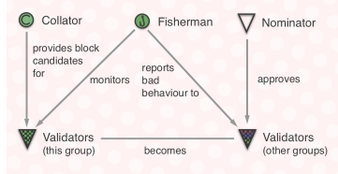
Consensus Roles

